Slide 1
https://www.youtube.com/watch?v=fCMrO_VzeL8
GitHub repository for the series: https://github.com/justmarkham/pandas...
"read_csv" documentation: http://pandas.pydata.org/pandas-docs/...
"isnull" documentation: http://pandas.pydata.org/pandas-docs/...
"notnull" documentation: http://pandas.pydata.org/pandas-docs/...
"dropna" documentation: http://pandas.pydata.org/pandas-docs/...
"value_counts" documentation: http://pandas.pydata.org/pandas-docs/...
"fillna" documentation: http://pandas.pydata.org/pandas-docs/...
Working with missing data: http://pandas.pydata.org/pandas-docs/...

Slide 2
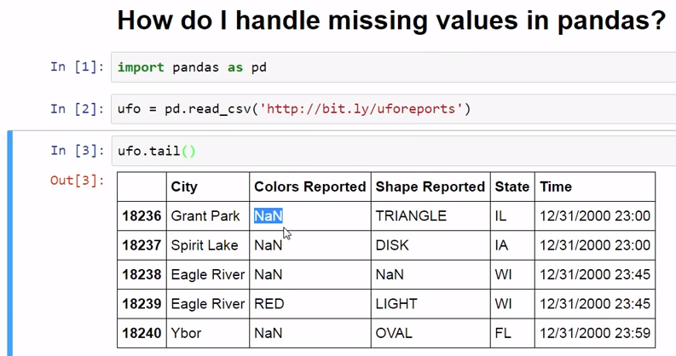
NaN : Not a Number

Slide 3
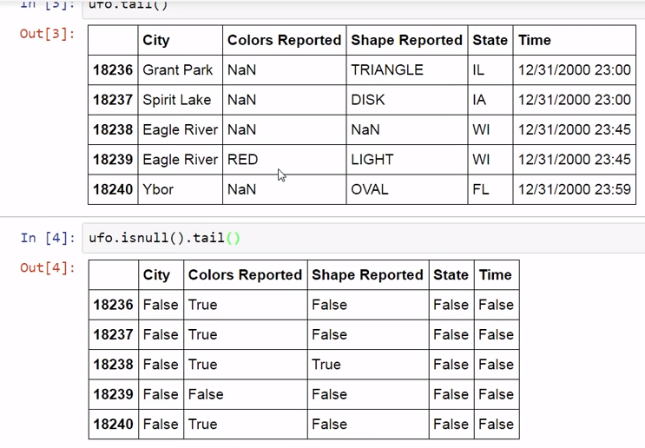

Slide 4
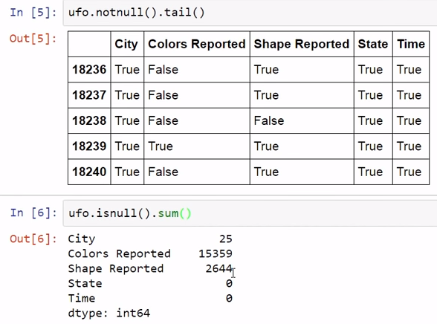
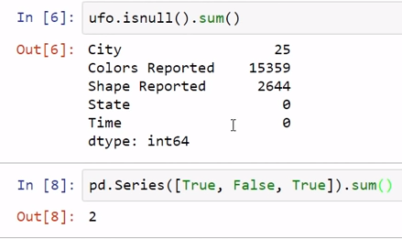

Slide 5
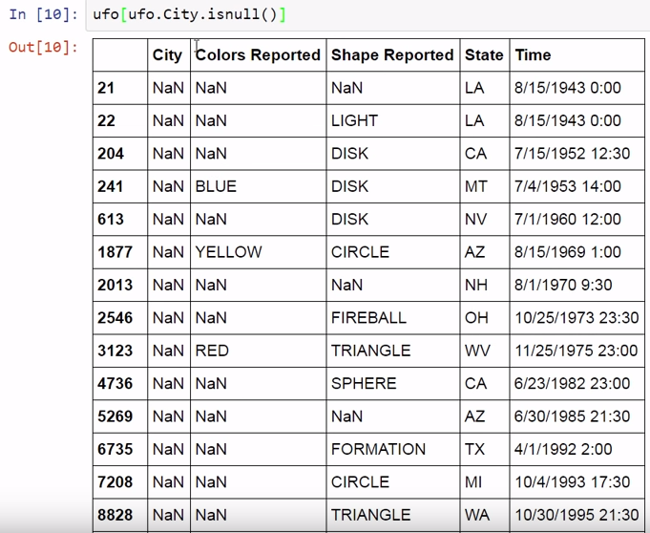

Slide 6
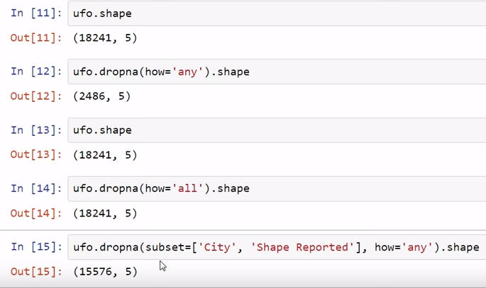


Slide 7
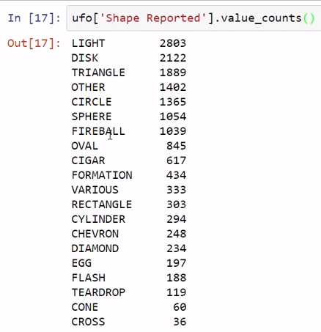
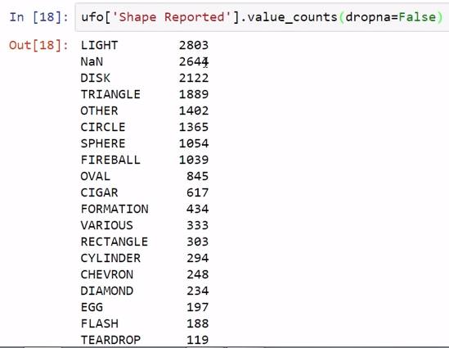

Slide 8
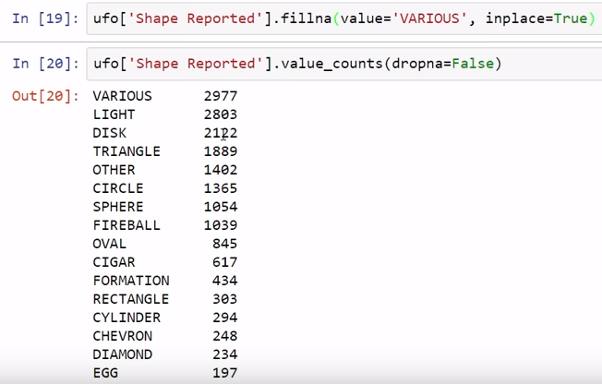

Slide 9
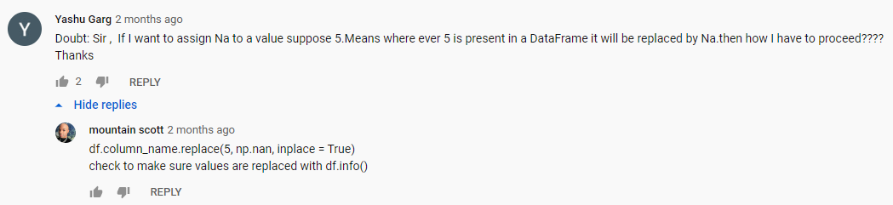
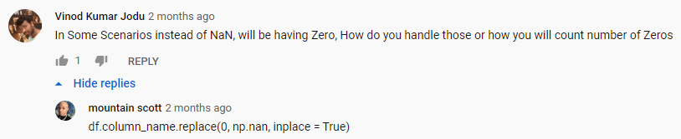

Slide 10
